Slide 1







Stack Overflow Developer Survey Data Report.
SHARANU
2023-01-07

Slide 2



OUTLINE
Executive Summary
Introduction
Methodology
Results
Visualization – Charts
Dashboard
Discussion
Findings & Implications
Conclusion
Appendix

Slide 3

EXECUTIVE SUMMARY
Current Technology Usage Trend
• Language
• Database
• Platform
• Web frame
Future Technology Trend
• Language
• Database
• Platform
• Web frame
• Demographics Survey
• Country & Gender Difference

Slide 4

INTRODUCTION
Analyze technology trend in software and web development among developers around the world
• Purpose of this Analysis
• Identify the top programming languages, database, platform and web frame skills in demand
• Identify skill requirements for future
• Identify human resource gap in the industry
• Audience for this Presentation
• Programmers
• IT industry leaders
• Computer science students

Slide 5

METHODOLOGY
Data Sources:
• Stack overflow developer survey
• GitHub job postings
• Programming languages annual salary
Data Wrangling:
A portion of the dataset was loaded and cleaned using SQL and Python’s pandas library.
• Cleaning procedure: Duplicates removal, data imputation,
data normalization
Analysis & Visualization:
EDA and data visualization were conducted using various Python libraries and Cognos.
the following measures were examined:
• Technologies (i.e., languages, databases, platforms, and web frames) used .
• Technologies most desired for the next year
• Demographics (i.e., gender, country, age, and education).

Slide 6
RESULTS

Slide 7
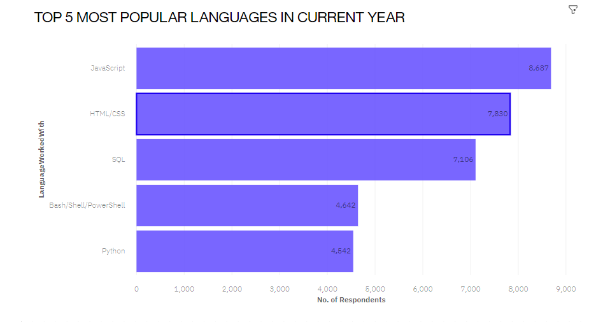
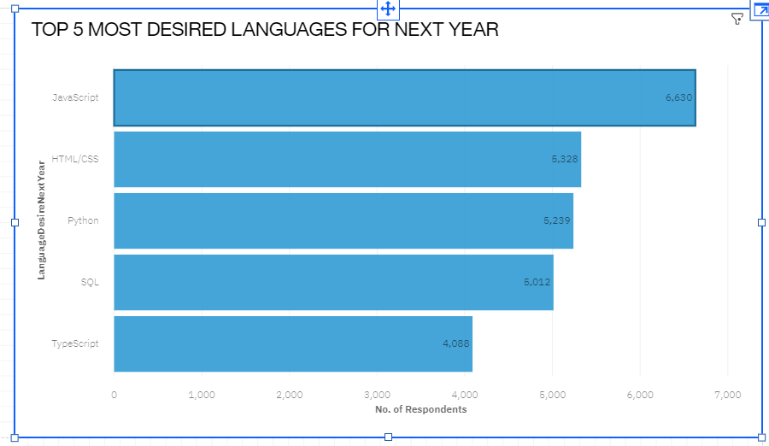
PROGRAMMING LANGUAGE TRENDS
Current Year
Next Year

Slide 8
PROGRAMMING LANGUAGE TRENDS - FINDINGS & IMPLICATIONS
Findings
JavaScript and HTML/CSS were the most popular And will likely remain so the following year.
SQL still has great portion in language usage trend.
Increasing interests in Python and TypeScript are making them more popular.
interest in PowerShell/Bash started decreasing.
Implications
• Web development is still in high demand, JavaScript and HTML/CSS remain the dominant languages. however, TypeScript may catch up in the future.
• SQL remains the preferred language for big data storage and querying—it’s not likely to go away anytime soon.
• Python’s rising popularity likely reflects the growth of AI and ML work.

Slide 9
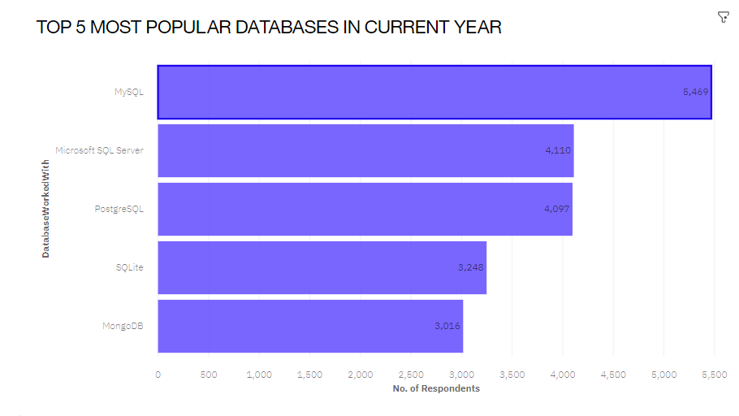
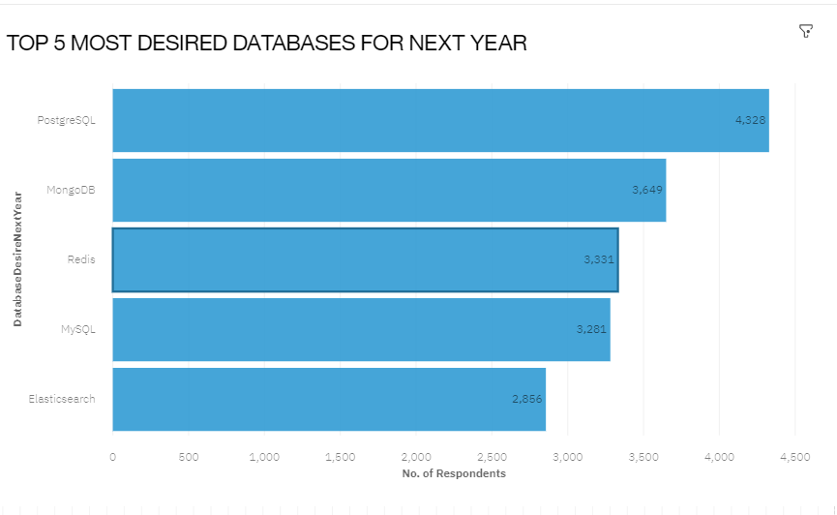
DATABASE TRENDS
Current Year
Next Year

Slide 10
DATABASE TRENDS - FINDINGS & IMPLICATIONS
Findings
SQL database programs were the most popular , with MySQL in the lead.
PostgreSQL is gaining popularity over other SQL database programs, and it was the overall most desired database for the next year.
MongoDB and Redis are the most favorable NoSQL database
Increasing interest in Elasticsearch.
Implications
• There appears to be increasing developer preference towards open-source database programs.
• NoSQL database programs are gaining popularity, which likely reflects a growing need to handle non relational and unstructured data.
• Current and aspiring data analysts should develop competence in NoSQL in addition to SQL database programs.

Slide 11

DASHBOARD
The permanent link of the read-only view of the Cognos dashboard:
https://dataplatform.cloud.ibm.com/dashboards/0cb6e45c-0770-4c0c-87af-5e4d63c1f830/view/641ecb783e9330d577eac8e407cb2a572b617309e7bb840b82877b490a342797f06b1b91c8291859dd405732fbed44089a

Slide 12
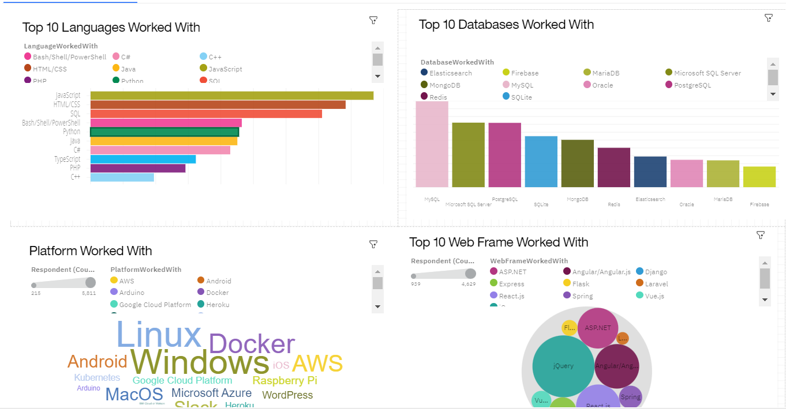
CURRENT TECHNOLOGY USAGE

Slide 13
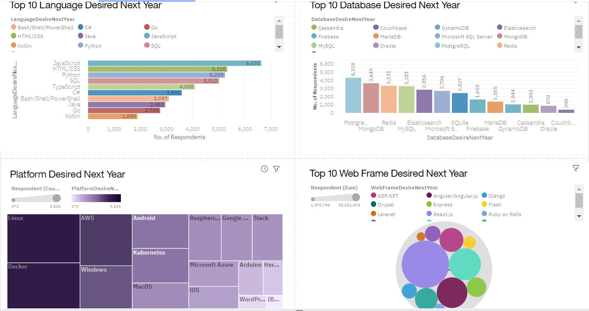
FUTURE TECHNOLOGY TREND

Slide 14
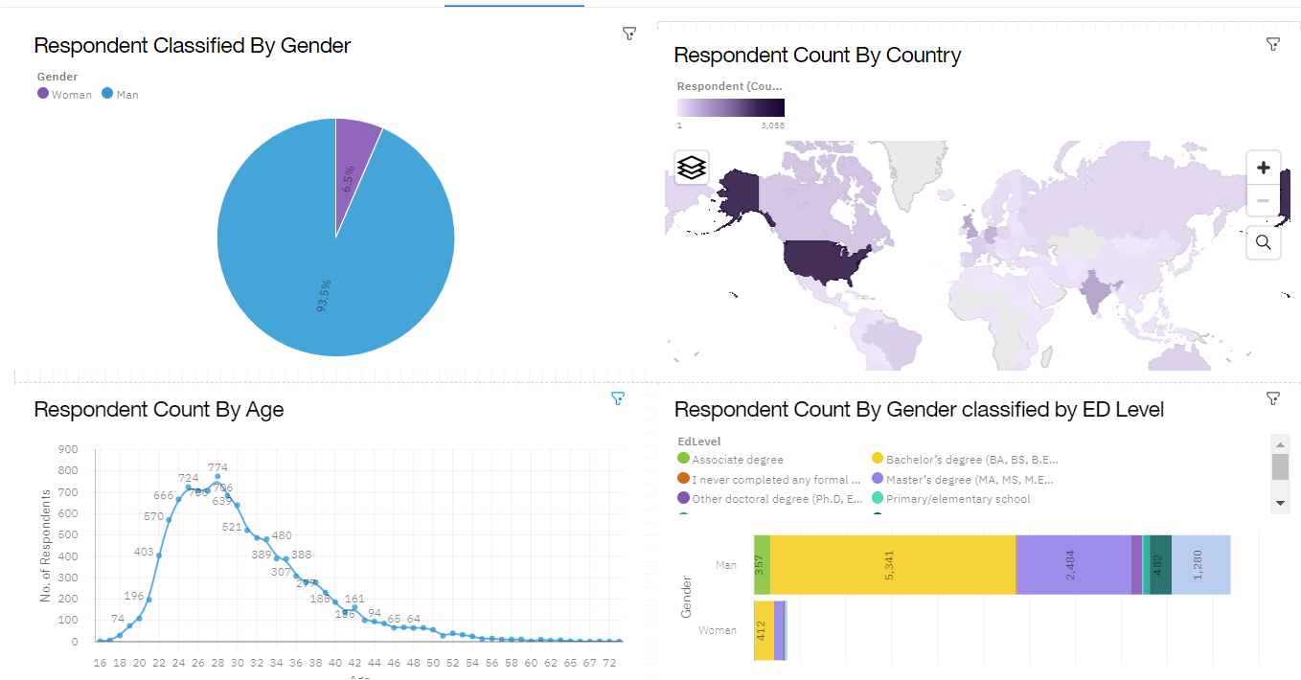
DEMOGRAPHICS

Slide 15
DISCUSSION
Taken together, the findings yield insights into the following questions:
• What kinds of developer technologies are in top demand ?
• Which technologies should prospective developers and data professionals be learning?
• Which technologies should educators place more emphasis on teaching in upcoming years?
• What does the distribution of annual compensation for developers look like?
• What is the developer demographic like? Is there a gender representation gap?

Slide 16
OVERALL FINDINGS & IMPLICATIONS
Findings
• Interest in JavaScript and html/CSS remain high as per usage too. There’s also increasing interest in typescript.
• Increasing interest in python pertaining to development of ai and ml.
• High usage and interest in SQL. MySQL had the highest usage, but PostgreSQL is gaining interest and was the overall most desired database program for the next year. NoSQL database programs gaining interest, of which MongoDb was the most used and desired for the next year.
• A severe gender representation gap (in favor of men), despite median compensation being slightly higher for women. Technology divide between countries.
Implications
Web development is still in high demand. Current and prospective developers may consider picking up typescript in addition to JavaScript and HTML/CSS.
With the growing need to handle big data and perform ai and ml work, data professionals should continue to enhance SQL competence but also enhance competence with NoSQL database programs and python.
Businesses need to adapt to changing technology preferences, especially in terms of talent acquisition and development.
Policy makers, educators, and organizations should work to minimize the gender representation gap in addition to the technology divide between countries.

Slide 17

CONCLUSION
A subset of data collected as part of the Stack Overflow Developer Survey was examined.
The findings yielded numerous insights into the technologies most used and desired by developers in addition to the developer demographic.
These insights should be particularly relevant for current and prospective developers aiming to remain competitive, businesses aiming to upskill their talent, educators in the field, and policy makers aiming to address gender and economic issues.

Slide 18

APPENDIX
Data on GitHub job postings for the 15 selected technologies shown above were collected using the GitHub Jobs API.
survey data regarding popular programming languages provided by IBM were collected.

Slide 19
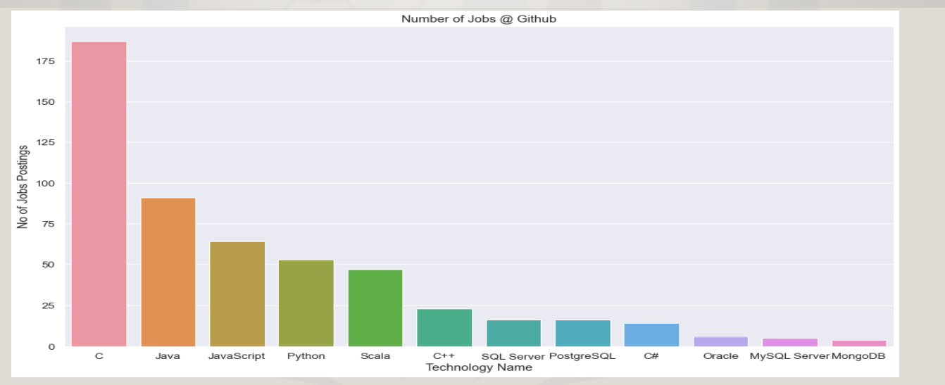
JOB POSTINGS

Slide 20
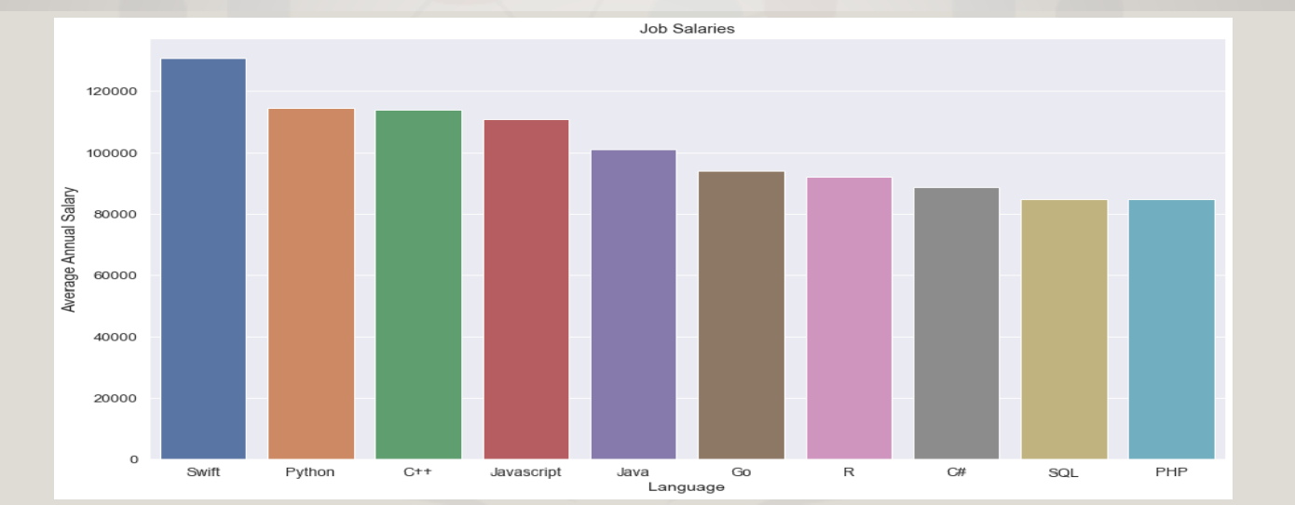
POPULAR LANGUAGES

